Slide 1
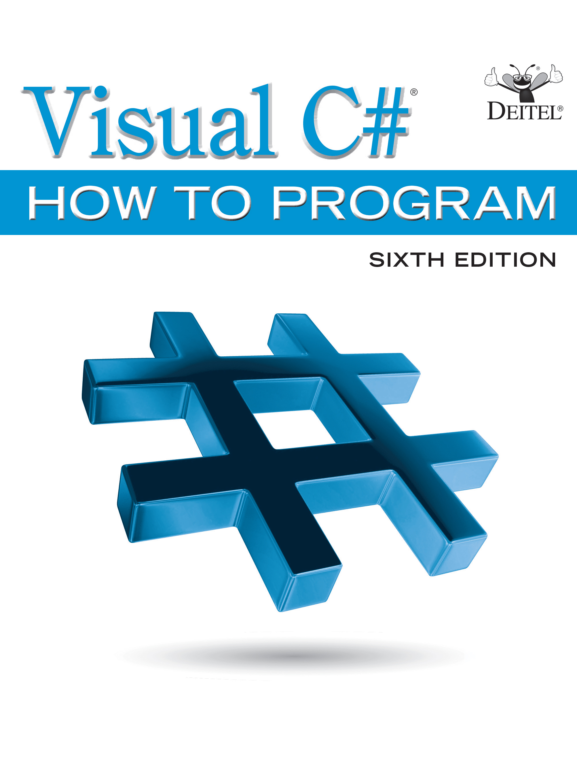
Visual C sharp® How to Program
Sixth Edition
Chapter 9
Introduction to L I N Q and the List Collection
Copyright © 2017 Pearson Education, Inc. All Rights Reserved
Notes:
If this PowerPoint presentation contains mathematical equations, you may need to check that your computer has the following installed:
1) MathType Plugin
2) Math Player (free versions available)
3) NVDA Reader (free versions available)

Slide 2
Learning Objectives (1 of 2)
Learn basic L I N Q concepts.
Query an array using a range variable and the from, where and select clauses.
Iterate over L I N Q query results.
Sort a L I N Q query’s results with the orderby clause.
Learn basic interface concepts and how the
interface enables a foreach to iterate over an array or collection’s elements.

Slide 3
Learning Objectives (2 of 2)
Learn basic .NET collections concepts.
Become familiar with commonly used methods of generic class List.
Create and use a generic List collection.
Query a generic List collection using L I N Q.
Declare multiple range variables in a L I N Q query with the let clause.
Understand how deferred execution helps make L I N Q queries reusable.

Slide 4
Outline (1 of 3)
9.1 Introduction
9.2 Querying an Array of int Values Using L I N Q
9.2.1 The from Clause
9.2.2 The where Clause
9.2.3 The select Clause
9.2.4 Iterating Through the Results of the L I N Q Query
9.2.5 The orderby Clause
9.2.6 Interface

Slide 5
Outline (2 of 3)
9.3 Querying an Array of Employee Objects Using L I N Q
9.3.1 Accessing the Properties of a L I N Q Query’s Range Variable
9.3.2 Sorting a L I N Q Query’s Results by Multiple Properties
9.3.3 Any, First and Count Extension Methods
9.3.4 Selecting a Property of an Object
9.3.5 Creating New Types in the select Clause of a L I N Q Query

Slide 6
Outline (3 of 3)
9.4 Introduction to Collections
9.4.1
Collection
9.4.2 Dynamically Resizing a
Collection
9.5 Querying the Generic List Collection Using L I N Q
9.5.1 The let Clause
9.5.2 Deferred Execution
9.5.3 Extension Methods ToArray and ToList
9.5.4 Collection Initializers
9.6 Wrap-Up
9.7 Deitel L I N Q Resource Center

Slide 7
9.1 Introduction (1 of 3)
A List is similar to an array but provides additional functionality, such as dynamic resizing.
A language called S Q L is the international standard used to perform queries (i.e., to request information that satisfies given criteria) and to manipulate data.
L I N Q (Language-Integrated Query) capabilities allow you to write query expressions that retrieve information from a variety of data sources, not just databases.

Slide 8
9.1 Introduction (2 of 3)
L I N Q to Objects can be used to filter arrays and Lists, selecting elements that satisfy a set of conditions
Figure 9.1 shows where and how we use L I N Q throughout the book to retrieve information from many data sources.
A L I N Q provider is a set of classes that implement L I N Q operations and enable programs to interact with data sources to perform tasks such as projecting, sorting, grouping and filtering elements.

Slide 9
Figure 9.1 L I N Q Usage Throughout the Book (1 of 2)
Chapter | Used to
Chapter 9, Introduction to L I N Q and the List Collection | Query arrays and Lists.
Chapter 16, Strings and Characters: A Deeper Look | Select G U I controls in a Windows Forms app (located in the online section of the chapter).
Chapter 17, Files and Streams | Search a directory and manipulate text files.
Chapter 21, Generic Collections; Functional Programming with L I N Q/P L I N Q | Show L I N Q method-call syntax with delegates and lambdas. Introduces functional-programming concepts, using L I N Q to Objects to write code more concisely and with fewer bugs than programs written with previous techniques. Shows how P L I N Q (Parallel L I N Q) can improve L I N Q to Objects performance substantially with multicore systems.

Slide 10
Figure 9.1 L I N Q Usage Throughout the Book (2 of 2)
Chapter | Used to
Chapter 22, Databases and L I N Q | Query information from a database using L I N Q to Entities. Like L I N Q to Objects, L I N Q to Entities is built into C sharp and the .NET Framework.
Chapter 23, Asynchronous Programming with async and await | Query an X M L response from a web service using L I N Q to X M L. Like L I N Q to Objects, L I N Q to X M L is built into C sharp and the .NET Framework.
Web App Development with A S P.NET online chapter | Retrieve information from a database to be used in a webbased app.
X M L and L I N Q to X M L online chapter | Present a more in-depth discussion of querying X M L documents using L I N Q to X M L.
REST Web Services online chapter | Query and update a database. Process X M L returned by W C F services.

Slide 11
9.1 Introduction (3 of 3)
There are two L I N Q approaches
One uses a S Q L-like syntax
The other uses method-call syntax.
This chapter shows the simpler S Q L-like syntax.
Chapter 21 shows the method-call syntax, introducing the notions of delegates and lambdas—mechanisms that enable you to pass methods to other methods to help them perform their tasks.

Slide 12
9.2 Querying an Array of int Values Using L I N Q
Figure 9.2 shows how to use L I N Q to Objects to query an array of integers, selecting elements that satisfy a set of conditions—a process called filtering
Iteration statements that filter arrays focus on the steps required to get the results. This is called imperative programming.
L I N Q queries specify the conditions that selected elements must satisfy. This is known as declarative programming.
The System.Linq namespace contains the L I N Q to Objects provider.

Slide 13
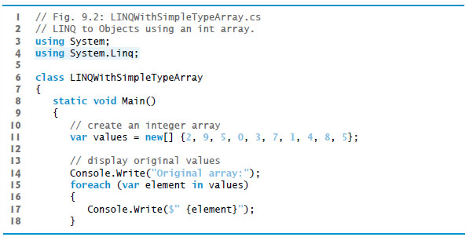
Figure 9.2 L I N Q to Objects Using an int Array (1 of 6)

Slide 14
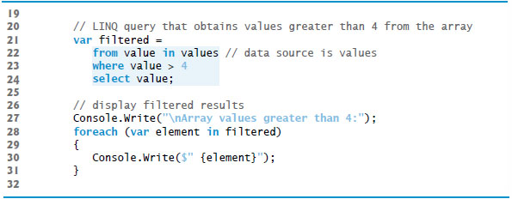
Figure 9.2 L I N Q to Objects Using an int Array (2 of 6)

Slide 15
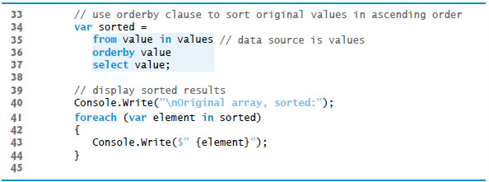
Figure 9.2 L I N Q to Objects Using an int Array (3 of 6)

Slide 16
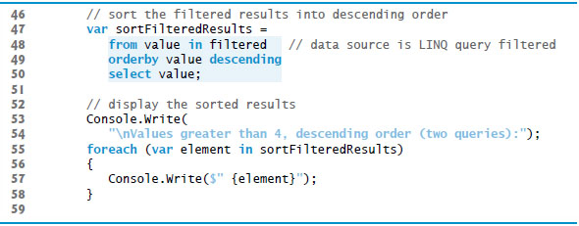
Figure 9.2 L I N Q to Objects Using an int Array (4 of 6)

Slide 17
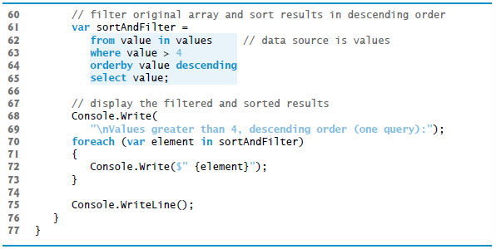
Figure 9.2 L I N Q to Objects Using an int Array (5 of 6)

Slide 18
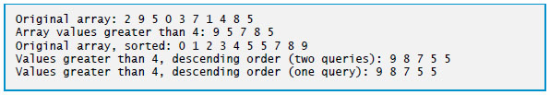
Figure 9.2 L I N Q to Objects Using an int Array (6 of 6)

Slide 19
9.2.1 The from Clause
A L I N Q query begins with a from clause, which specifies a range variable (value) and the data source to query (values).
The range variable represents each item in the data source, much like the control variable in a foreach statement.

Slide 20
9.2.2 The Where Clause
If the condition in the where clause evaluates to true, the element is selected.
A predicate is an expression that takes an element of a collection and returns true or false by testing a condition on that element.

Slide 21
9.2.3 The Select Clause
The select clause determines what value appears in the results.

Slide 22
9.2.5 The Orderby Clause
The orderby clause sorts the query results in ascending order.
The descending modifier in the orderby clause sorts the results in descending order.
Any value that can be compared with other values of the same type may be used with the orderby clause.

Slide 23
9.2.6 Interface
The
interface describes the functionality of
any object that can be iterated over and thus offers members to access each element.
Arrays and collections already implement the
interface.
A L I N Q query returns an object that implements the
interface.
With L I N Q, the code that selects elements and the code that displays them are kept separate, making the code easier to understand and maintain.

Slide 24
9.3 Querying an Array of Employee Objects Using L I N Q
L I N Q is not limited to querying arrays of simple types such as integers.
It cannot be used when a query does not have a defined meaning—for example, you cannot use orderby on objects values that are not comparable.
Comparable types in .NET are those that implement the
All built-in types, such as string, int and double implement
Figure 9.3 presents the Employee class. Figure 9.4 uses L I N Q to query an array of Employee objects.

Slide 25
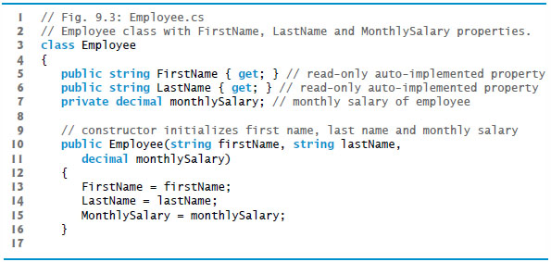
Figure 9.3 Employee Class with FirstName, LastName and MonthlySalary Properties (1 of 2)

Slide 26
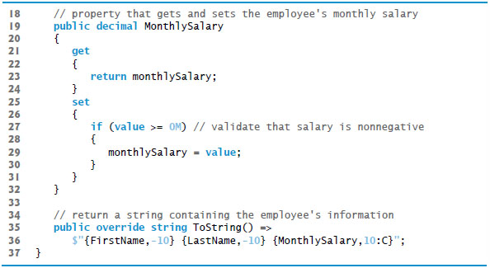
Figure 9.3 Employee Class with FirstName, LastName and MonthlySalary Properties (2 of 2)

Slide 27
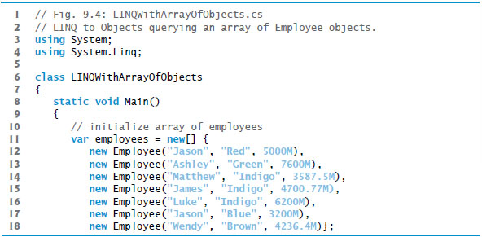
Figure 9.4 L I N Q to Objects Querying an Array of Employee Objects (1 of 7)

Slide 28
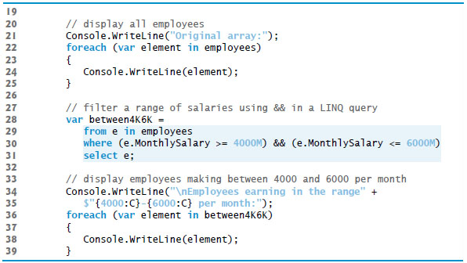
Figure 9.4 L I N Q to Objects Querying an Array of Employee Objects (2 of 7)

Slide 29
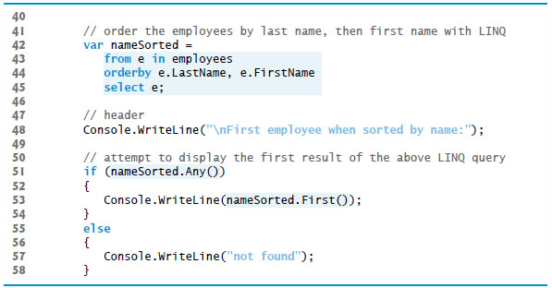
Figure 9.4 L I N Q to Objects Querying an Array of Employee Objects (3 of 7)

Slide 30
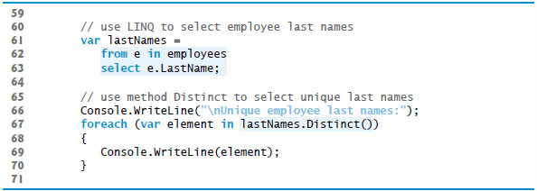
Figure 9.4 L I N Q to Objects Querying an Array of Employee Objects (4 of 7)

Slide 31
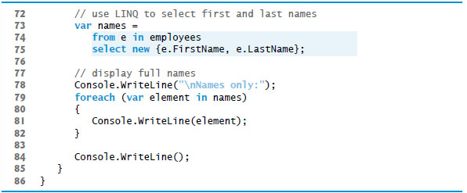
Figure 9.4 L I N Q to Objects Querying an Array of Employee Objects (5 of 7)

Slide 32
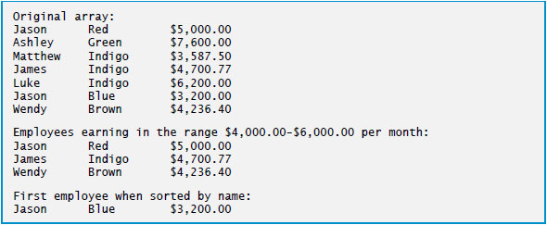
Figure 9.4 L I N Q to Objects Querying an Array of Employee Objects (6 of 7)

Slide 33
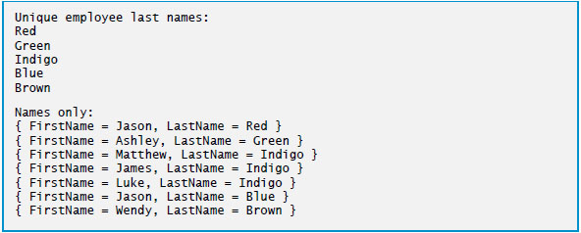
Figure 9.4 L I N Q to Objects Querying an Array of Employee Objects (7 of 7)

Slide 34
9.3.1 Accessing the Properties of a L I N Q Query’s Range Variable
A where clause can access the properties of the range variable.
The conditional AND
operator can be used to
combine conditions.

Slide 35
9.3.2 Sorting a L I N Q Query’s Results by Multiple Properties
An orderby clause can sort the results according to multiple properties, specified in a comma-separated list.

Slide 36
9.3.3 Any, First and Count Extension Methods
The query result’s Any method returns true if there is at least one element, and false if there are no elements.
The query result’s First method returns the first element in the result.
The Count method of the query result returns the number of elements in the results.

Slide 37
9.3.4 Selecting a Property of an Object
The select clause can be used to select a member of the range variable rather than the range variable itself.
The Distinct method removes duplicate elements, causing all elements in the result to be unique.

Slide 38

9.3.5 Creating New Types in the Select Clause of a L I N Q Query (1 of 3)
The select clause can create a new object of anonymous type (a type with no name), which the compiler generates for you based on the properties listed in the curly braces ({}).
By default, the name of the property being selected is used as the property’s name in the result.
You can specify a different name for the property inside the anonymous type definition

Slide 39
9.3.5 Creating New Types in the Select Clause of a L I N Q Query (2 of 3)
Implicitly typed local variables allow you to use anonymous types because you do not have to explicitly state the type when declaring such variables.
When the compiler creates an anonymous type, it automatically generates a ToString method that returns a string representation of the object.

Slide 40
9.3.5 Creating New Types in the Select Clause of a L I N Q Query (3 of 3)
Creating an anonymous type in a L I N Q quere is an example of a projection—it performs a transformation on the data.
The transformation creates new objects containing only the specified properties
Such rransformations can also manipulate the data.
For example, you could give all employees a 10% raise by multiplying their MonthlySalary properties by 1.1.

Slide 41
9.4 Introduction to Collections (1 of 4)
The .NET Framework Class Library provides several classes, called collections, used to store groups of related objects.
These classes provide efficient methods that organize, store and retrieve your data without requiring knowledge of how the data is being stored.

Slide 42
9.4.1 List left angle bracket T right angle bracket Collection
The generic collection class
(from namespace
System.Collections.Generic) does not need to be reallocated to change its size.
is called a generic class because it can be used with any type of object.
T is a placeholder for the type of the objects stored in the list.
Figure 9.5 shows some common methods and properties of class

Slide 43
Figure 9.5 Some Methods and Properties of Class List left angle bracket T right angle bracket (1 of 2)
Method or property | Description
Add | Adds an element to the end of the List.
AddRange | Adds the elements of its collection argument to the end of the List.
Capacity | Property that gets or sets the number of elements a List can store without resizing.
Clear | Removes all the elements from the List.
Contains | Returns true if the List contains the specified element and false otherwise.
Count | Property that returns the number of elements stored in the List.
IndexOf | Returns the index of the first occurrence of the specified value in the List.

Slide 44
Figure 9.5 Some Methods and Properties of Class List left angle bracket T right angle bracket (2 of 2)
Method or property | Description
Insert | Inserts an element at the specified index.
Remove | Removes the first occurrence of the specified value.
RemoveAt | Removes the element at the specified index.
RemoveRange | Removes a specified number of elements starting at a specified index.
Sort | Sorts the List.
TrimExcess | Sets the Capacity of the List to the number of elements the List currently contains (Count).

Slide 45
9.4.2 Dynamically Resizing a List left angle bracket T right angle bracket Collection
Figure 9.6 demonstrates dynamically resizing a List object.
The Count property returns the number of elements currently in the List.
The Capacity property indicates how many items the List can hold without having to grow.
When the List is created, both are initially 0—though the Capacity is implementation dependent.

Slide 46
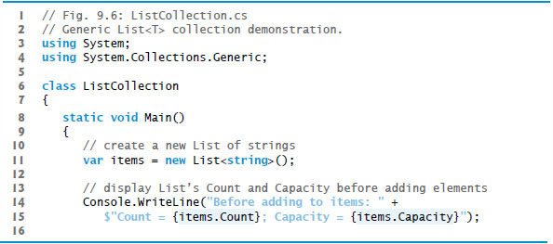
Figure 9.6 Generic List left angle bracket T right angle bracket Collection Demonstration (1 of 7)

Slide 47
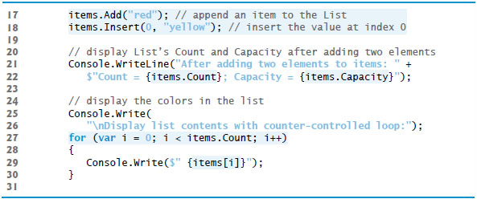
Figure 9.6 Generic List left angle bracket T right angle bracket Collection Demonstration (2 of 7)

Slide 48
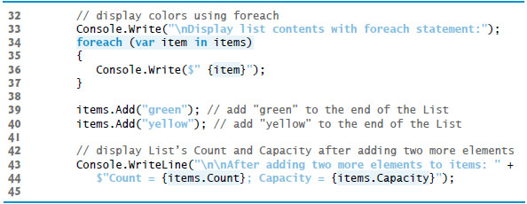
Figure 9.6 Generic List left angle bracket T right angle bracket Collection Demonstration (3 of 7)

Slide 49
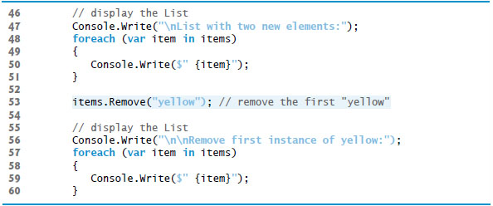
Figure 9.6 Generic List left angle bracket T right angle bracket Collection Demonstration (4 of 7)

Slide 50
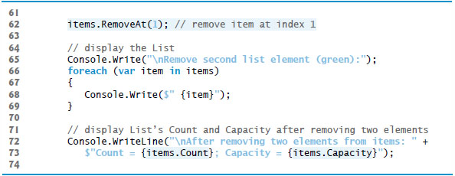
Figure 9.6 Generic List left angle bracket T right angle bracket Collection Demonstration (5 of 7)

Slide 51
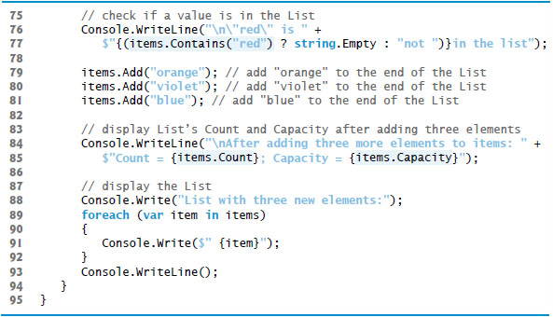
Figure 9.6 Generic List left angle bracket T right angle bracket Collection Demonstration (6 of 7)

Slide 52
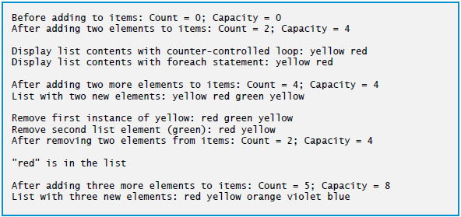
Figure 9.6 Generic List left angle bracket T right angle bracket Collection Demonstration (7 of 7)

Slide 53
9.4 Introduction to Collections (2 of 4)
The Add method appends its argument to the end of the List.
The Insert method inserts a new element at the specified position.
The first argument is an index—as with arrays, collection indices start at zero.
The second argument is the value that’s to be inserted at the specified index.
The indices of elements at the specified index and above increase by one.

Slide 54
9.4 Introduction to Collections (3 of 4)
Lists can be indexed like arrays by placing the index in square brackets after the List variable’s name.
The Remove method is used to remove the first instance of an element with a specific value.
If no such element is in the List, Remove does nothing.
RemoveAt removes the element at the specified index; the indices of all elements above that index decrease by one.

Slide 55
9.4 Introduction to Collections (4 of 4)
The Contains method returns true if the element is found in the List, and false otherwise.
Contains compares its argument to each element of the List in order, so using Contains on a large List is inefficient.
When the List grows, it must create a larger internal array and copy each element to the new array.
A List grows only when an element is added and there is no space for the new element.

Slide 56
Performance Tip 9.1
Doubling a List’s Capacity is an efficient way for a List to grow quickly to be “about the right size.” This operation is much more efficient than growing a List by only as much space as it takes to hold the element(s) being added. A disadvantage is that the List might occupy more space than it requires. This is a classic example of the space/time trade-off.

Slide 57
Performance Tip 9.2
It can be wasteful to double a List’s size when more space is needed. For example, a full List of 1,000,000 elements resizes to accommodate 2,000,000 elements when one new element is added. This leaves 999,999 unused elements. You can use TrimExcess (as in yourListObject.TrimExcess()) to reduce a List’s Capacity to its current Count. You also can set the Capacity directly to control space usage better—for example, if you know a List will never grow beyond 100 elements, you can preallocate that space by assigning 100 to the List’s Capacity or using the List constructor that receives an initial capacity.

Slide 58
9.5 Querying a Generic Collection Using L I N Q
You can use L I N Q to Objects to query Lists just as arrays.
In Figure 9.7, a List of strings is converted to uppercase and searched for those that begin with “R”.

Slide 59
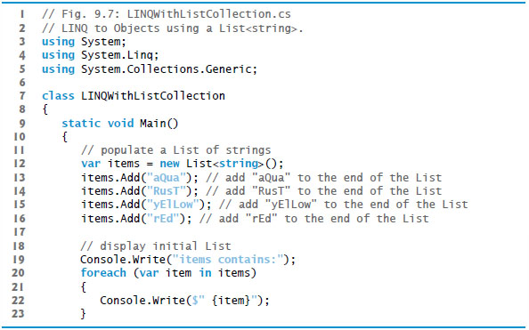
Figure 9.7 L I N Q to Objects Using a List left angle bracket string right angle bracket (1 of 4)

Slide 60
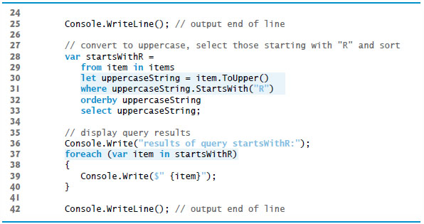
Figure 9.7 L I N Q to Objects Using a List left angle bracket string right angle bracket (2 of 4)

Slide 61
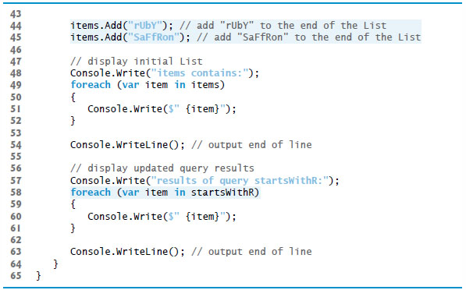
Figure 9.7 L I N Q to Objects Using a List left angle bracket string right angle bracket (3 of 4)

Slide 62

Figure 9.7 L I N Q to Objects Using a List left angle bracket string right angle bracket (4 of 4)

Slide 63
9.5.1 The Let Clause
L I N Q’s let clause can be used to create a new range variable to store a temporary result for use later in the L I N Q query.
The string method ToUpper to converts a string to uppercase.
The string method StartsWith performs a case sensitive comparison to determine whether a string starts with the string received as an argument.

Slide 64
9.5.2 Deferred Execution
L I N Q uses deferred execution—the query executes only when you access the results, not when you define the query.

Slide 65
Performance Tip 9.3
Deferred execution can improve performance when a query’s results are not immediately needed.

Slide 66
9.5.3 Extension Methods ToArray and ToList
L I N Q extension methods ToArray and ToList immediately execute the query on which they are called.
These methods execute the query only once, improving efficiency.

Slide 67
Performance Tip 9.4
Methods ToArray and ToList also can improve efficiency if you’ll be iterating over the same results multiple times, as you execute the query only once.

Slide 68
9.5.4 Collection Initializers
Collection initializers provide a convenient syntax (similar to array initializers) for initializing a collection. For example, lines 12–16 of Figure 9.7(see slide 59) could be replaced with:
Explicitly creates the
with new, so the
compiler knows that the initializer list contains elements for a
The following declaration would generate a compilation error, because the compiler cannot determine whether you wish to create an array or a collection

Slide 69

Copyright

